Slide 1


CodeArena - A Programming Platform
Department of Information and Communication Technology
Presented By :-
Aryan Langhnoja - 92200133030
Abhay Nathwani - 92310133007
Subject :- Capstone Project (01CT0715)
Semester - 7
Faculty :- Prof. Chandrasinh Parmar

Slide 2
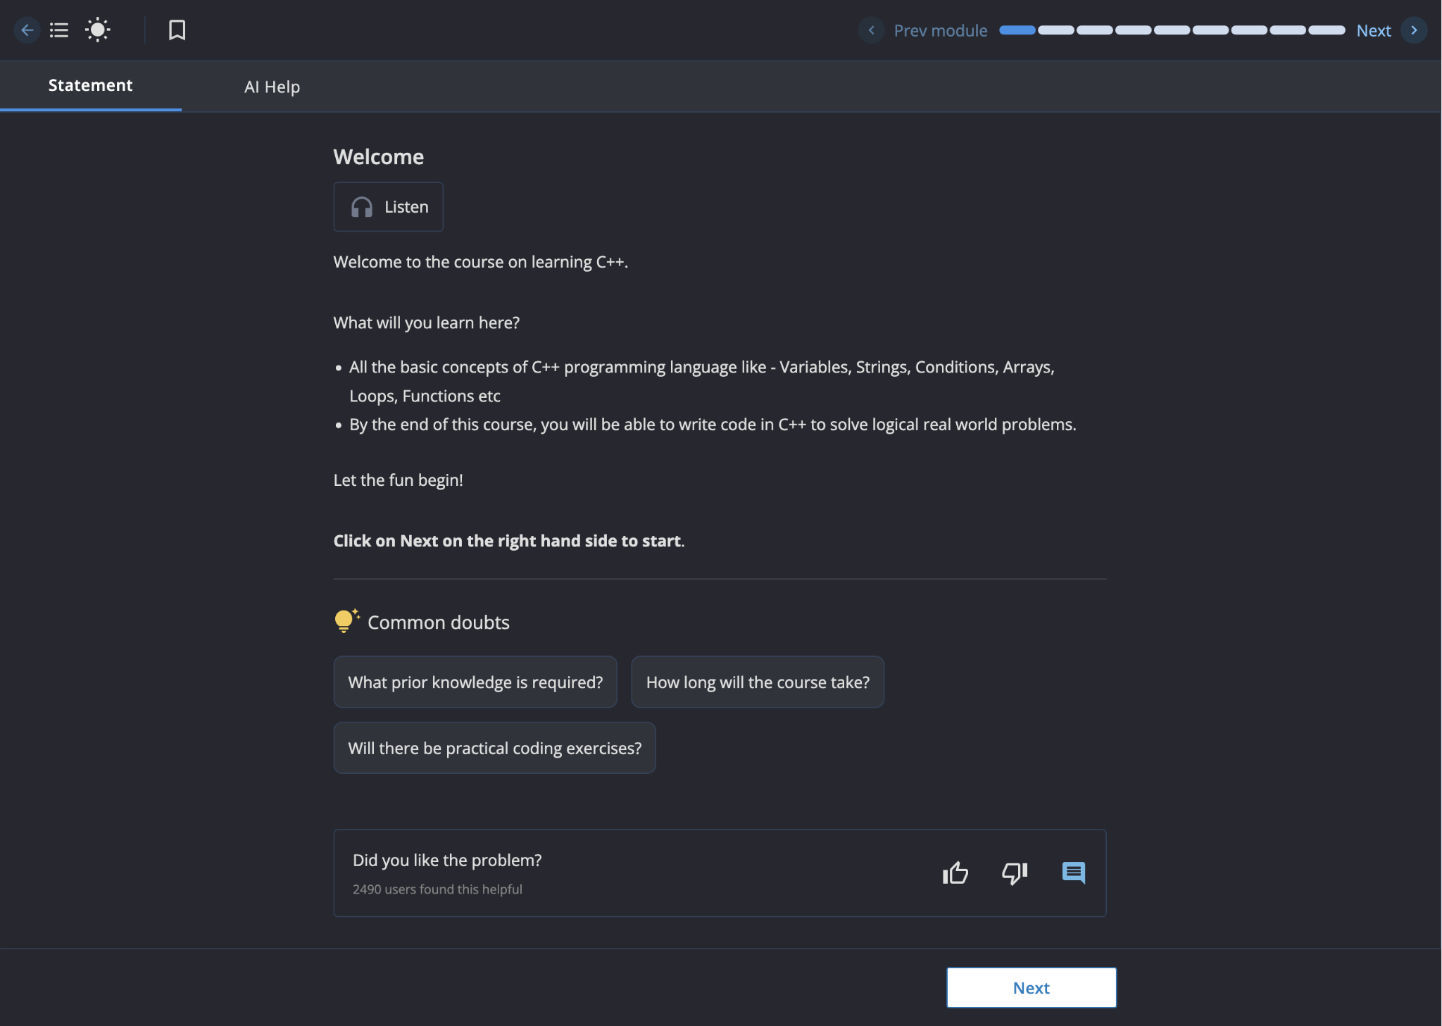
The Problem
The Challenge: A Disconnected Learning Experience
CodeChef

Slide 3
Our Solution: CodeArena
Key Benefits:
For Students: Centralized, curriculum-aligned practice.
For Faculty: Powerful tools for content management and student analytics.
For the University: A direct bridge to industry-readiness.

Slide 4
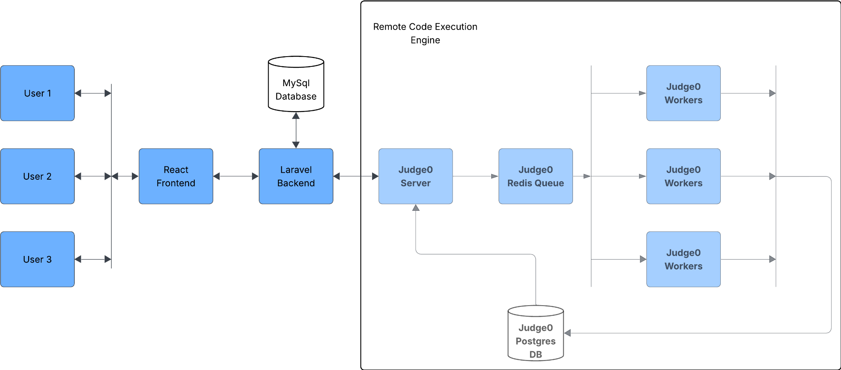
Technical Highlights
Key Technologies Listed:
Frontend: React.js
Backend: Laravel (PHP)
RCE Engine: Judge0 (Secure & Containerized)
Infrastructure: Docker

Slide 5
Impact & Future Work
Project Impact:
Students: Improved skill development and industry readiness.
Faculty: Time saved via auto-grading and data-driven teaching insights.
University: Enhanced academic quality and student placement outcomes
Future Work:
AI Learning Path: Implement a true ML model for personalized problem recommendations.
Plagiarism Detection: Integrate a module to ensure academic integrity.
Public Cloud Deployment: Migrate to the university VPS for public access.

Slide 6


